Slide 1
CS162 Operating Systems and Systems Programming Lecture 12 Address Translation
March 2nd, 2016
Prof. Anthony D. Joseph
http://cs162.eecs.Berkeley.edu

Slide 2

Review: Simple Example: Base and Bounds (CRAY-1)
Base
Virtual
Address
CPU
+
DRAM
Physical
Address
Bound
(Limit)
<?
No: Error!
Could use base/bounds for dynamic address translation – translation happens at execution:
Alter address of every load/store by adding “base”
Generate error if address bigger than limit
This gives program the illusion that it is running on its own dedicated machine, with memory starting at 0
Program gets continuous region of memory
Addresses within program do not have to be relocated when program placed in different region of DRAM

Slide 3
Review: Issues with Simple B&B Method
process 6
process 6
process 6
process 6
process 5
process 5
process 5
process 9
process 9
process 11
process 2
process 10
OS
OS
OS
OS
Fragmentation problem over time
Not every process is same size ➔ memory becomes fragmented
Missing support for sparse address space
Would like to have multiple chunks/program (Code, Data, Stack)
Hard to do inter-process sharing
Want to share code segments when possible
Want to share memory between processes
Helped by providing multiple segments per process

Slide 4
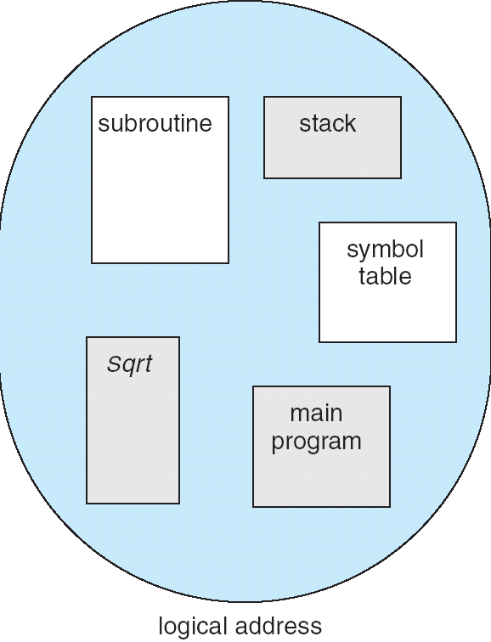
More Flexible Segmentation
1
1
1
4
2
3
2
2
4
3
user view of
memory space
physical
memory space
Logical View: multiple separate segments
Typical: Code, Data, Stack
Others: memory sharing, etc
Each segment is given region of contiguous memory
Has a base and limit
Can reside anywhere in physical memory

Slide 5
Implementation of Multi-Segment Model
Virtual
Address
offset
>
Seg #
Offset
Error
Base0
Limit0
V
Base1
Limit1
V
Base2
Limit2
V
Base2
Limit2
V
Base3
Limit3
N
+
Physical
Address
Base4
Limit4
V
Base5
Limit5
N
Base6
Limit6
N
Base7
Limit7
V
Check Valid
Segment map resides in processor
Segment number mapped into base/limit pair
Base added to offset to generate physical address
Error check catches offset out of range
As many chunks of physical memory as entries
Segment addressed by portion of virtual address
However, could be included in instruction instead:
x86 Example: mov [es:bx],ax.
What is “V/N” (valid / not valid)?
Can mark segments as invalid; requires check as well
Access
Error

Slide 6
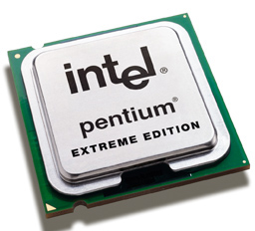
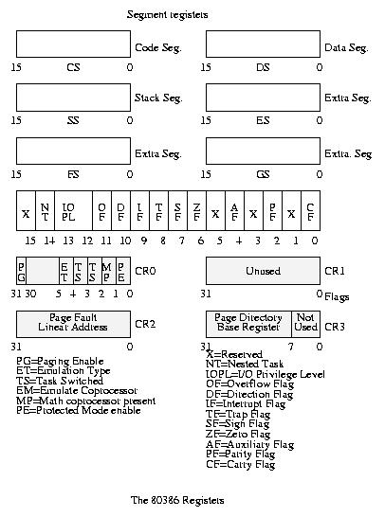
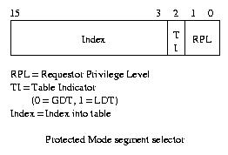
Intel x86 Special Registers
80386 Special Registers
Typical Segment Register
Current Priority is RPL
Of Code Segment (CS)

Slide 7
Example: Four Segments (16 bit addresses)
Seg ID # | Base | Limit
0 (code) | 0x4000 | 0x0800
1 (data) | 0x4800 | 0x1400
2 (shared) | 0xF000 | 0x1000
3 (stack) | 0x0000 | 0x3000
Seg
Offset
15
14
13
0
Virtual Address Format
SegID = 0
0x0000
0x0000
SegID = 1
0x4000
Might
be shared
0x4000
0x4800
0x5C00
0x8000
Space for
Other Apps
0xC000
0xF000
Shared with
Other Apps
Virtual
Address Space
Physical
Address Space

Slide 8
Example of Segment Translation
0x240 main: la $a0, varx 0x244 jal strlen
… …
0x360 strlen: li $v0, 0 ;count 0x364 loop: lb $t0, ($a0) 0x368 beq $r0,$t1, done
… …
0x4050 varx dw 0x314159
Seg ID # | Base | Limit
0 (code) | 0x4000 | 0x0800
1 (data) | 0x4800 | 0x1400
2 (shared) | 0xF000 | 0x1000
3 (stack) | 0x0000 | 0x3000
Let’s simulate a bit of this code to see what happens (PC=0x240):
Fetch 0x240. Virtual segment #? 0; Offset? 0x240
Physical address? Base=0x4000, so physical addr=0x4240
Fetch instruction at 0x4240. Get “la $a0, varx”
Move 0x4050 → $a0, Move PC+4→PC
Fetch 0x244. Translated to Physical=0x4244. Get “jal strlen” Move 0x0248 → $ra (return address!), Move 0x0360 → PC
Fetch 0x360. Translated to Physical=0x4360. Get “li $v0,0” Move 0x0000 → $v0, Move PC+4→PC
Fetch 0x364. Translated to Physical=0x4364. Get “lb $t0,($a0)” Since $a0 is 0x4050, try to load byte from 0x4050
Translate 0x4050. Virtual segment #? 1; Offset? 0x50 Physical address? Base=0x4800, Physical addr = 0x4850,
Load Byte from 0x4850→$t0, Move PC+4→PC

Slide 9
Observations about Segmentation
Virtual address space has holes
Segmentation efficient for sparse address spaces
A correct program should never address gaps (except as mentioned in moment)
If it does, trap to kernel and dump core
When it is OK to address outside valid range:
This is how the stack and heap are allowed to grow
For instance, stack takes fault, system automatically increases size of stack
Need protection mode in segment table
For example, code segment would be read-only
Data and stack would be read-write (stores allowed)
Shared segment could be read-only or read-write
What must be saved/restored on context switch?
Segment table stored in CPU, not in memory (small)
Might store all of processes memory onto disk when switched (called “swapping”)

Slide 10
Problems with Segmentation
Must fit variable-sized chunks into physical memory
May move processes multiple times to fit everything
Limited options for swapping to disk
Fragmentation: wasted space
External: free gaps between allocated chunks
Internal: don’t need all memory within allocated chunks

Slide 11
Recall: General Address Translation
Code
Data
Heap
Stack
Data 2
Code
Data
Heap
Stack
Stack 1
Heap 1
Code 1
Stack 2
Prog 1
Virtual
Address
Space 1
Data 1
Prog 2
Virtual
Address
Space 2
Heap 2
Code 2
OS code
Translation Map 1
OS data
Translation Map 2
OS heap &
Stacks
Physical Address Space

Slide 12
Paging: Physical Memory in Fixed Size Chunks
Solution to fragmentation from segments?
Allocate physical memory in fixed size chunks (“pages”)
Every chunk of physical memory is equivalent
Can use simple vector of bits to handle allocation: 00110001110001101 … 110010
Each bit represents page of physical memory 1⇒allocated, 0⇒free
Should pages be as big as our previous segments?
No: Can lead to lots of internal fragmentation
Typically have small pages (1K-16K)
Consequently: need multiple pages/segment

Slide 13
How to Implement Paging?
Virtual Address:
Virtual
Page #
Offset
PageTablePtr
page #0
V,R
Physical
Page #
Offset
page #1
V,R
page #1
V,R
page #2
V,R,W
Physical Address
PageTableSize
>
page #3
V,R,W
Check Perm
Access
Error
page #4
N
page #5
V,R,W
Access
Error
Page Table (One per process)
Resides in physical memory
Contains physical page and permission for each virtual page
Permissions include: Valid bits, Read, Write, etc
Virtual address mapping
Offset from Virtual address copied to Physical Address
Example: 10 bit offset ⇒ 1024-byte pages
Virtual page # is all remaining bits
Example for 32-bits: 32-10 = 22 bits, i.e. 4 million entries
Physical page # copied from table into physical address
Check Page Table bounds and permissions

Slide 14
Simple Page Table Example
Example (4 byte pages)
0x00
0000 0000
0x00
a
b
c
d
0001 0000
0x04
0
4
i
j
k
l
0x04
0000 0100
1
0000 1100
0x05!
e
f
g
h
3
2
1
0000 0100
0x08
0x06?
0x08
0000 1000
Page
Table
0x0C
i
j
k
l
e
f
g
h
0x09?
0x0E!
0x10
Virtual
Memory
0000 0110
0000 1110
a
b
c
d
0000 1001
0000 0101
Physical
Memory
Notes:
What is virtual address 0x6? 1|10 = 3|2 = 0xE
What is virtual address 0x9? 10|01 = 1|1 = 0x5

Slide 15
What about Sharing?
Virtual Address
(Process A):
Virtual
Page #
Offset
PageTablePtrA
page #0
V,R
page #1
V,R
page #2
V,R,W
page #2
V,R,W
page #3
V,R,W
Shared
Page
page #4
N
page #5
V,R,W
PageTablePtrB
page #0
V,R
page #1
N
This physical page
appears in address
space of both processes
page #2
V,R,W
page #3
N
page #4
V,R
page #4
V,R
page #5
V,R,W
Virtual Address
(Process B):
Virtual
Page #
Offset

Slide 16
Administrivia
Upcoming deadlines:
Project 1 final code due Fri 3/4, final report due Mon 3/7
Midterm next week Wed 3/9 6-7:30 10 Evans and 155 Dwinelle
Midterm review session: Sun 3/6 2-5PM at 2060 VLSB
Rooms assignment: aa-eh 10 Evans, ej-oa 155 Dwinelle
Lectures (including #12), project, homeworks readings, textbook
No books, no calculators, one double-side page handwritten notes
No class that day, extra office hours

Slide 17
break

Slide 18
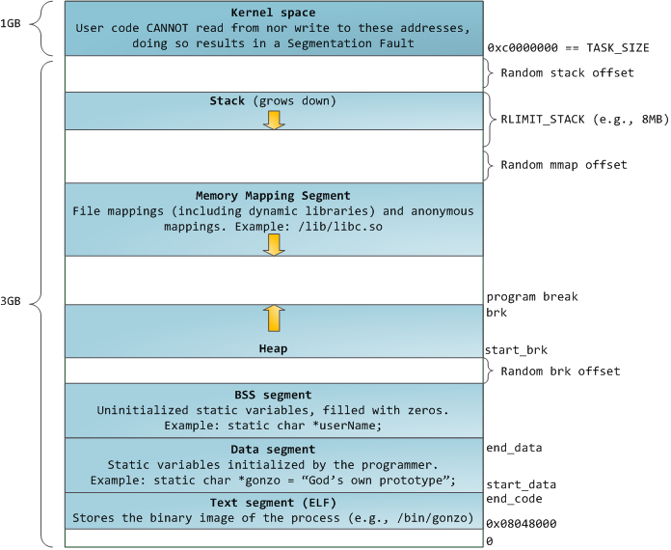
Memory Layout for Linux 32-bit
http://static.duartes.org/img/blogPosts/linuxFlexibleAddressSpaceLayout.png

Slide 19
Summary: Paging
Page Table
Virtual memory view
Physical memory view
1111 1111
11111 11101
11110 11100
11101 null
11100 null
11011 null
11010 null
11001 null
11000 null
10111 null
10110 null
10101 null
10100 null
10011 null
10010 10000
10001 01111
10000 01110
01111 null
01110 null
01101 null
01100 null
01011 01101
01010 01100
01001 01011
01000 01010
00111 null
00110 null
00101 null
00100 null
00011 00101
00010 00100
00001 00011
00000 00010
1110 1111
1111 0000
stack
stack
1110 0000
1100 0000
heap
1000 0000
heap
0111 000
data
data
0101 000
0100 0000
code
code
0001 0000
0000 0000
0000 0000
page #
offset

Slide 20
Summary: Paging
Page Table
Virtual memory view
Physical memory view
1111 1111
11111 11101
11110 11100
11101 null
11100 null
11011 null
11010 null
11001 null
11000 null
10111 null
10110 null
10101 null
10100 null
10011 null
10010 10000
10001 01111
10000 01110
01111 null
01110 null
01101 null
01100 null
01011 01101
01010 01100
01001 01011
01000 01010
00111 null
00110 null
00101 null
00100 null
00011 00101
00010 00100
00001 00011
00000 00010
stack
1110 0000
stack
1110 0000
1100 0000
What happens if stack grows to 1110 0000?
heap
1000 0000
heap
0111 000
data
data
0101 000
0100 0000
code
code
0001 0000
0000 0000
0000 0000
page #
offset

Slide 21
Summary: Paging
Page Table
Virtual memory view
Physical memory view
1111 1111
11111 11101
11110 11100
11101 10111
11100 10110
11011 null
11010 null
11001 null
11000 null
10111 null
10110 null
10101 null
10100 null
10011 null
10010 10000
10001 01111
10000 01110
01111 null
01110 null
01101 null
01100 null
01011 01101
01010 01100
01001 01011
01000 01010
00111 null
00110 null
00101 null
00100 null
00011 00101
00010 00100
00001 00011
00000 00010
stack
1110 0000
stack
1110 0000
1100 0000
stack
Allocate new pages where room!
heap
1000 0000
heap
0111 000
data
Challenge: Table size equal to # of pages in virtual memory!
data
0101 000
0100 0000
code
code
0001 0000
0000 0000
0000 0000
page #
offset

Slide 22
Page Table Discussion
What needs to be switched on a context switch?
Page table pointer and limit
Analysis
Pros
Simple memory allocation
Easy to Share
Con: What if address space is sparse?
E.g. on UNIX, code starts at 0, stack starts at (2³¹-1).
With 1K pages, need 2 million page table entries!
Con: What if table really big?
Not all pages used all the time ⇒ would be nice to have working set of page table in memory
How about combining paging and segmentation?
Notes:
What if page size is very small? VAX had a 512-byte page size = lots of space for page table entries
What if page size is really big? Wastes space inside of page (internal fragmentation)

Slide 23
Fix for sparse address space: The two-level page table
Physical
Address:
Physical
Page #
Offset
10 bits
10 bits
12 bits
Virtual
Address:
Virtual
P1 index
Virtual
P2 index
Offset
4KB
PageTablePtr
4 bytes
Tree of Page Tables
Tables fixed size (1024 entries)
On context-switch: save single PageTablePtr register
Valid bits on Page Table Entries
Don’t need every 2nd-level table
Even when exist, 2nd-level tables can reside on disk if not in use
4 bytes

Slide 24
Summary: Two-Level Paging
Virtual memory view
Page Tables
(level 2)
Physical memory view
1111 1111
stack
11 11101
10 11100
01 10111
00 10110
stack
1110 0000
1111 0000
1100 0000
Page Table
(level 1)
stack
111
110 null
101 null
100
011 null
010
001 null
000
11 null
10 10000
01 01111
00 01110
heap
1000 0000
heap
0111 000
11 01101
10 01100
01 01011
00 01010
data
data
0101 000
0100 0000
11 00101
10 00100
01 00011
00 00010
code
page2 #
code
0001 0000
0000 0000
0000 0000
page1 #
offset

Slide 25
Summary: Two-Level Paging
Virtual memory view
Page Tables
(level 2)
Physical memory view
stack
11 11101
10 11100
01 10111
00 10110
stack
1110 0000
Page Table
(level 1)
stack
111
110 null
101 null
100
011 null
010
001 null
000
11 null
10 10000
01 01111
00 01110
1001 0000
(0x90)
heap
heap
1000 0000
(0x80)
In best case, total size of page tables ≈ number of pages used by program virtual memory. Requires two additional memory access!
11 01101
10 01100
01 01011
00 01010
data
data
11 00101
10 00100
01 00011
00 00010
code
code
0001 0000
0000 0000

Slide 26
Multi-level Translation: Segments + Pages
What about a tree of tables?
Lowest level page table⇒memory still allocated with bitmap
Higher levels often segmented
Could have any number of levels. Example (top segment):
What must be saved/restored on context switch?
Contents of top-level segment registers (for this example)
Pointer to top-level table (page table)
Virtual
Address:
Virtual
Seg #
Virtual
Page #
Offset
page #0
V,R
Base0
Limit0
V
page #1
V,R
Physical
Page #
Offset
page #2
V,R,W
Base1
Limit1
V
page #2
V,R,W
Physical Address
Base2
Limit2
V
page #3
V,R,W
Base2
Limit2
V
Base3
Limit3
N
page #4
N
Base4
Limit4
V
page #5
V,R,W
Check Perm
Base5
Limit5
N
Base6
Limit6
N
Base7
Limit7
V
>
Access
Error
Access
Error

Slide 27
What about Sharing (Complete Segment)?
Process
A
Virtual
Seg #
Virtual
Page #
Offset
page #0
V,R
page #1
V,R
page #2
V,R,W
Base0
Limit0
V
page #3
V,R,W
Base1
Limit1
V
page #4
N
Base2
Limit2
V
Base2
Limit2
V
page #5
V,R,W
Base3
Limit3
N
Base4
Limit4
V
Shared Segment
Base5
Limit5
N
Base6
Limit6
N
Base0
Limit0
V
Base7
Limit7
V
Base1
Limit1
V
Base2
Base2
Limit2
Limit2
V
V
Base3
Limit3
N
Base4
Limit4
V
Base5
Limit5
N
Base6
Limit6
N
Base7
Limit7
V
Process
B
Virtual
Seg #
Virtual
Page #
Offset

Slide 28
Multi-level Translation Analysis
Pros:
Only need to allocate as many page table entries as we need for application
In other wards, sparse address spaces are easy
Easy memory allocation
Easy Sharing
Share at segment or page level (need additional reference counting)
Cons:
One pointer per page (typically 4K – 16K pages today)
Page tables need to be contiguous
However, previous example keeps tables to exactly one page in size
Two (or more, if >2 levels) lookups per reference
Seems very expensive!

Slide 29
What is in a Page Table Entry?
What is in a Page Table Entry (or PTE)?
Pointer to next-level page table or to actual page
Permission bits: valid, read-only, read-write, write-only
Example: Intel x86 architecture PTE:
Address same format previous slide (10, 10, 12-bit offset)
Intermediate page tables called “Directories”
P: Present (same as “valid” bit in other architectures)
W: Writeable
U: User accessible
PWT: Page write transparent: external cache write-through
PCD: Page cache disabled (page cannot be cached)
A: Accessed: page has been accessed recently
D: Dirty (PTE only): page has been modified recently
L: L=1⇒4MB page (directory only). Bottom 22 bits of virtual address serve as offset
Page Frame Number
(Physical Page Number)
Free
(OS)
0
L
D
A
PCD
PWT
U
W
P
31-12
11-9
8
7
6
5
4
3
2
1
0

Slide 30
Examples of how to use a PTE
How do we use the PTE?
Invalid PTE can imply different things:
Region of address space is actually invalid or
Page/directory is just somewhere else than memory
Validity checked first
OS can use other (say) 31 bits for location info
Usage Example: Demand Paging
Keep only active pages in memory
Place others on disk and mark their PTEs invalid
Usage Example: Copy on Write
UNIX fork gives copy of parent address space to child
Address spaces disconnected after child created
How to do this cheaply?
Make copy of parent’s page tables (point at same memory)
Mark entries in both sets of page tables as read-only
Page fault on write creates two copies
Usage Example: Zero Fill On Demand
New data pages must carry no information (say be zeroed)
Mark PTEs as invalid; page fault on use gets zeroed page
Often, OS creates zeroed pages in background

Slide 31
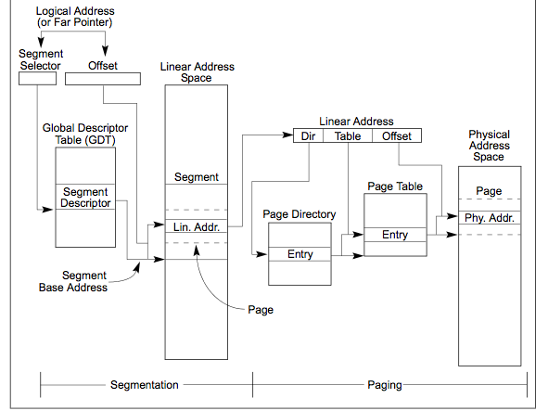
Making it real: X86 Memory model with segmentation (16/32-bit)

Slide 32

X86 Segment Descriptors (32-bit Protected Mode)
Segments are either implicit in the instruction (say for code segments) or actually part of the instruction
There are 6 registers: SS, CS, DS, ES, FS, GS
What is in a segment register?
A pointer to the actual segment description: G/L selects between GDT and LDT tables (global vs local descriptor tables)
Two registers: GDTR and LDTR hold pointers to the global and local descriptor tables in memory
Includes length of table (for < 2¹³) entries
Descriptor format (64 bits):
G: Granularity of segment (0: 16bit, 1: 4KiB unit) DB: Default operand size (0; 16bit, 1: 32bit) A: Freely available for use by software P: Segment present DPL: Descriptor Privilege Level S: System Segment (0: System, 1: code or data) Type: Code, Data, Segment
Segment selector [13 bits]
G/L
RPL

Slide 33
Recall: How are segments used?
One set of global segments (GDT) for everyone, different set of local segments (LDT) for every process
In legacy applications (16-bit mode):
Segments provide protection for different components of user programs
Separate segments for chunks of code, data, stacks
Limited to 64K segments
Modern use in 32-bit Mode:
Segments “flattened”, i.e. every segment is 4GB in size
One exception: Use of GS (or FS) as a pointer to “Thread Local Storage” (TLS)
A thread can make accesses to TLS like this: mov eax, gs(0x0)
Modern use in 64-bit (“long”) mode
Most segments (SS, CS, DS, ES) have zero base and no length limits
Only FS and GS retain their functionality (for use in TLS)

Slide 34
break

Slide 35
X86_64: Four-level page table!
9 bits
9 bits
9 bits
9 bits
12 bits
48-bit Virtual
Address:
Virtual
P1 index
Virtual
P2 index
Virtual
P3 index
Virtual
P4 index
Offset
PageTablePtr
8 bytes
4096-byte pages (12 bit offset) Page tables also 4k bytes (pageable)
Physical
Address:
(40-50 bits)
Physical Page #
12bit Offset

Slide 36
IA64: 64bit addresses: Six-level page table?!?
64bit Virtual
Address:
7 bits
9 bits
9 bits
9 bits
9 bits
9 bits
12 bits
Virtual
P1 index
Virtual
P2 index
Virtual
P3 index
Virtual
P4 index
Virtual
P5 index
Virtual
P6 index
Offset
No!
Too slow
Too many almost-empty tables
Notes:
Only really use last two levels (1 GB)

Slide 37
Inverted Page Table
With all previous examples (“Forward Page Tables”)
Size of page table is at least as large as amount of virtual memory allocated to processes
Physical memory may be much less
Much of process space may be out on disk or not in use
Answer: use a hash table
Called an “Inverted Page Table”
Size is independent of virtual address space
Directly related to amount of physical memory
Very attractive option for 64-bit address spaces
Cons: Complexity of managing hash changes
Often in hardware!
Virtual
Page #
Offset
Hash
Table
Physical
Page #
Offset

Slide 38
IA64: Inverse Page Table (IPT)
Idea: index page table by physical pages instead of VM
0x0000
VMpage0
VMpage1
VMpage2
VMpage3
VMpage0, pid 0
0x1000
0x2000
pid 0 | VMpage0
pid 1 | …
pid 0 | VMpage2
pid 0 | VMpage1
xx | free
pid 2 | …
pid 1 | …
pid 0 | VMpage3
0x0
0x3000
0x1
VMpage2, pid 0
Process id 0
Virtual memory
0x4000
0x2
VMpage1, pid 0
0x3
0x5000
0x4
0x6000
0x5
0x7000
0x6
VMpage3, pid 0
0x7
Physical memory in 4kB pages
Page numbers in red
Inverse Page Table

Slide 39
IPT address translation
Need an associative map from VM page to IPT address:
Use a hash map
Process 0 virtual address
Physical address
VMpage2 (52b) | Offset (12b)
0x3 | Offset (12b)
0x0000
pid 0 | VMpage0
pid 1
pid 0 | VMpage1
pid 0 | VMpage2
xx | free
pid 2
pid 1
pid 0 | VMpage3
0x0
VMpage0, pid 0
0x1
0x1000
0x2
0x2000
0x3
0x3000
Hash VM page #
0x4
VMpage2, pid 0
0x4000
0x5
VMpage1, pid 0
0x5000
0x6
0x7
0x6000
Inverse Page Table
0x7000
VMpage3, pid 0

Slide 40
Summary: Inverted Table
Virtual memory view
Physical memory view
1111 1111
Inverted Table
Hash(procID & virt. page #) =
phys. page #
stack
1110 0000
stack
1110 0000
1100 0000
stack
1011 0000
h(11111) =
h(11110) =
h(11101) =
h(11100) =
h(10010)=
h(10001)=
h(10000)=
h(01011)=
h(01010)=
h(01001)=
h(01000)=
h(00011)=
h(00010)=
h(00001)=
h(00000)=
11101
11100
10111
10110
10000
01111
01110
01101
01100
01011
01010
00101
00100
00011
00010
heap
1000 0000
heap
0111 0000
data
Total size of page table ≈ number of pages used by program in physical memory. Hash more complex
data
0101 0000
0100 0000
code
code
0001 0000
0000 0000
0000 0000
page #
offset

Slide 41
Address Translation Comparison
 | Advantages | Disadvantages
Simple Segmentation | Fast context switching: Segment mapping maintained by CPU | External fragmentation
Paging (single-level page) | No external fragmentation, fast easy allocation | Large table size ~ virtual memory Internal fragmentation
Paged segmentation | Table size ~ # of pages in virtual memory, fast easy allocation | Multiple memory references per page access
Two-level pages
Inverted Table | Table size ~ # of pages in physical memory | Hash function more complex

Slide 42
Summary
Segment Mapping
Segment registers within processor
Segment ID associated with each access
Often comes from portion of virtual address
Can come from bits in instruction instead (x86)
Each segment contains base and limit information
Offset (rest of address) adjusted by adding base
Page Tables
Memory divided into fixed-sized chunks of memory
Virtual page number from virtual address mapped through page table to physical page number
Offset of virtual address same as physical address
Large page tables can be placed into virtual memory
Multi-Level Tables
Virtual address mapped to series of tables
Permit sparse population of address space
Inverted page table
Size of page table related to physical memory size

